Slide 1
Variables
Notes:
https://www.excel-easy.com/vba/create-a-macro.html

Slide 2
Table of Contents
Lesson Overview
Integer
String
Double
Boolean
Variable scoping
Life of Variables

Slide 3
Lesson Overview
This chapter teaches you how to declare, initialize and display a variable in Excel VBA. Letting Excel VBA know you are using a variable is called declaring a variable. Initializing simply means assigning a beginning (initial) value to a variable.
Place a command button on your worksheet and add the code lines below. To execute the code lines, click the command button on the sheet.

Slide 4
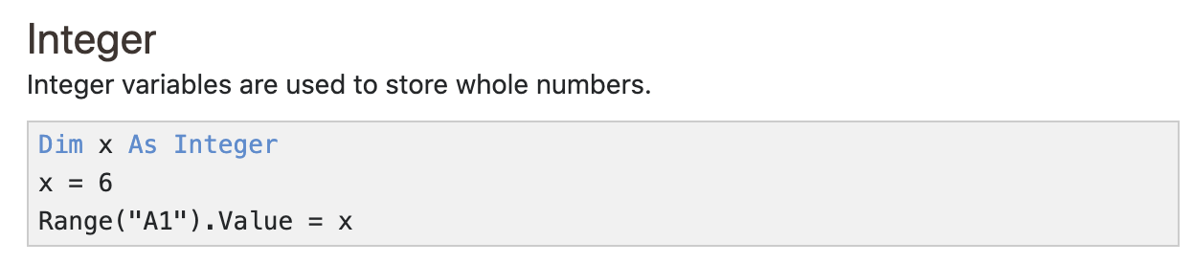
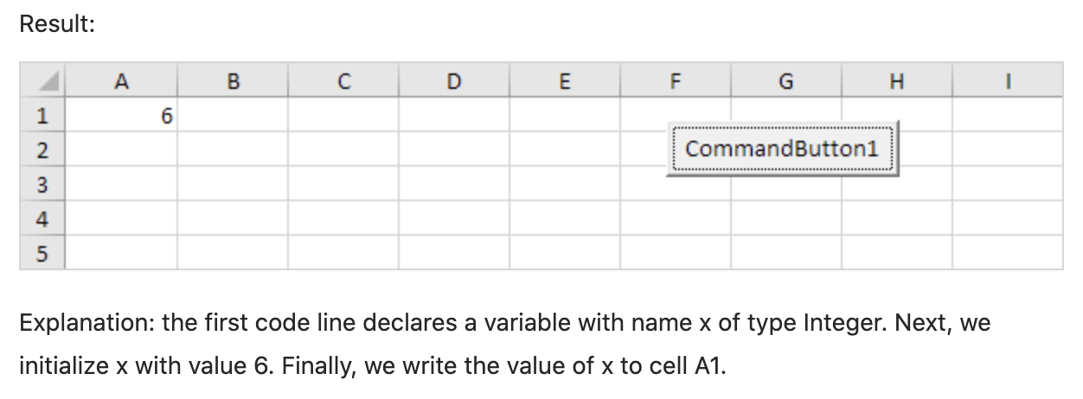
Integer

Slide 5
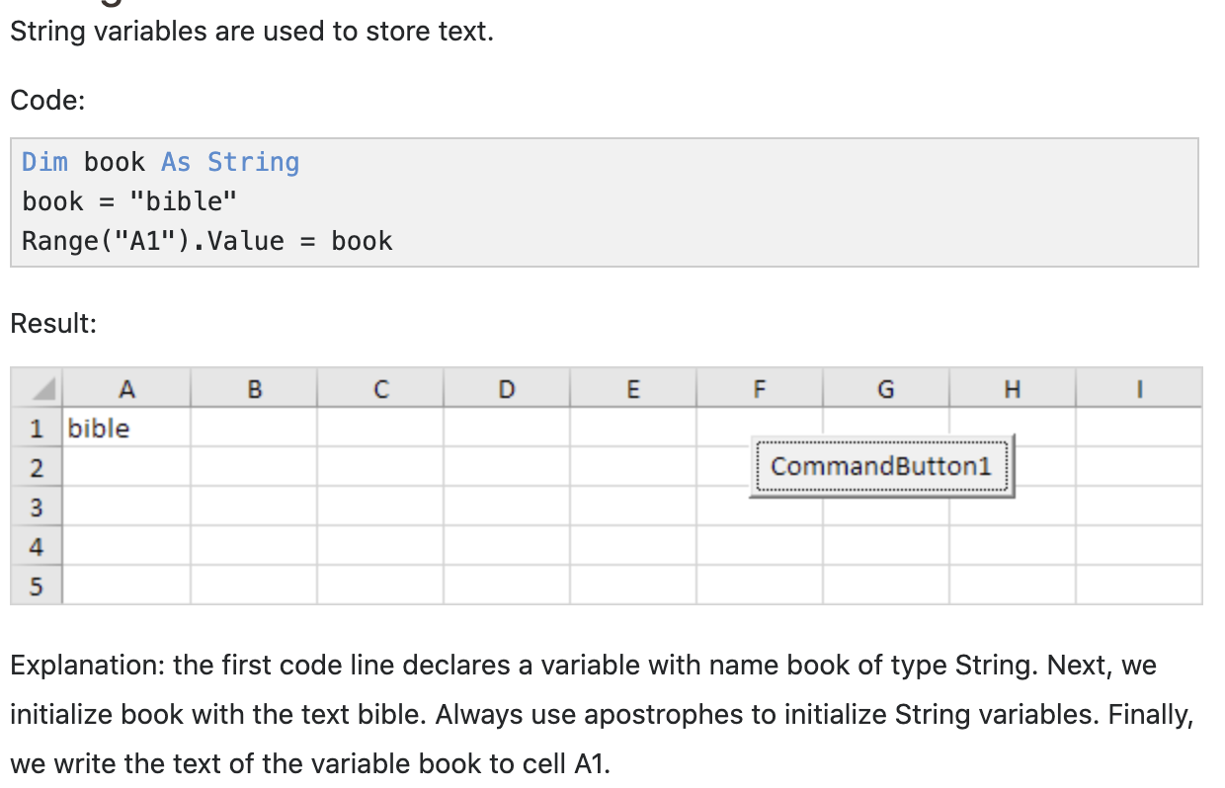
String

Slide 6
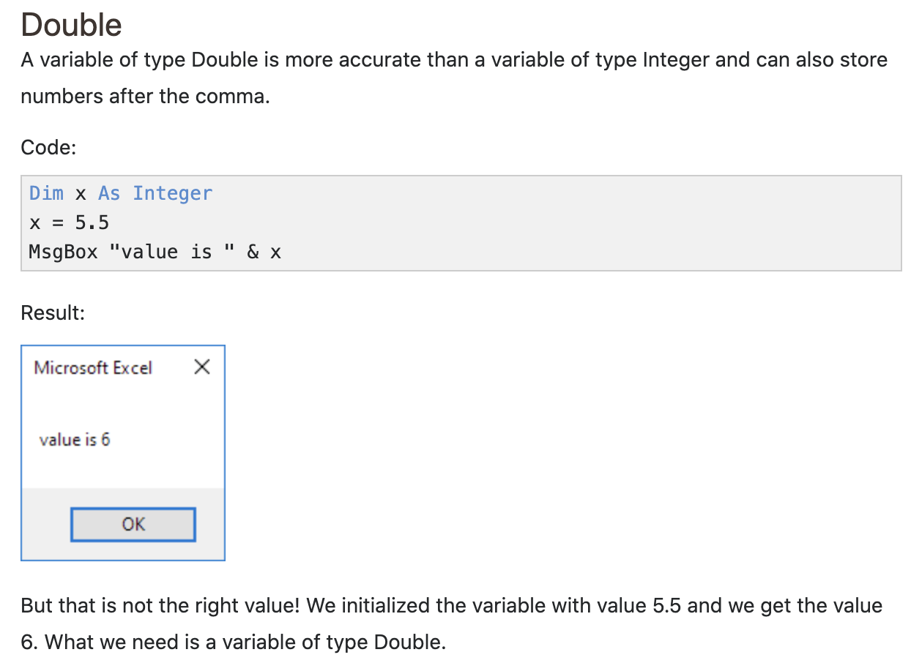
Double

Slide 7
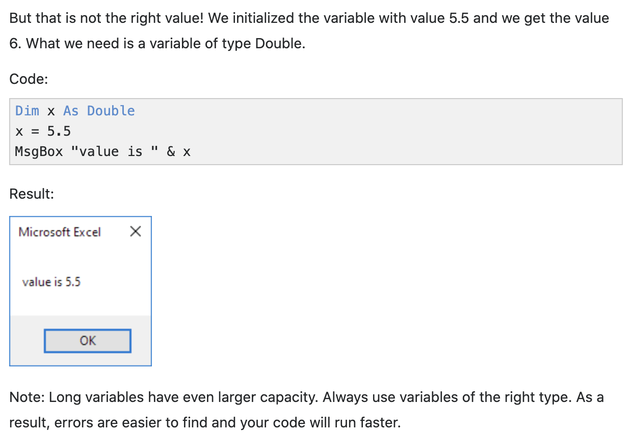
Double

Slide 8
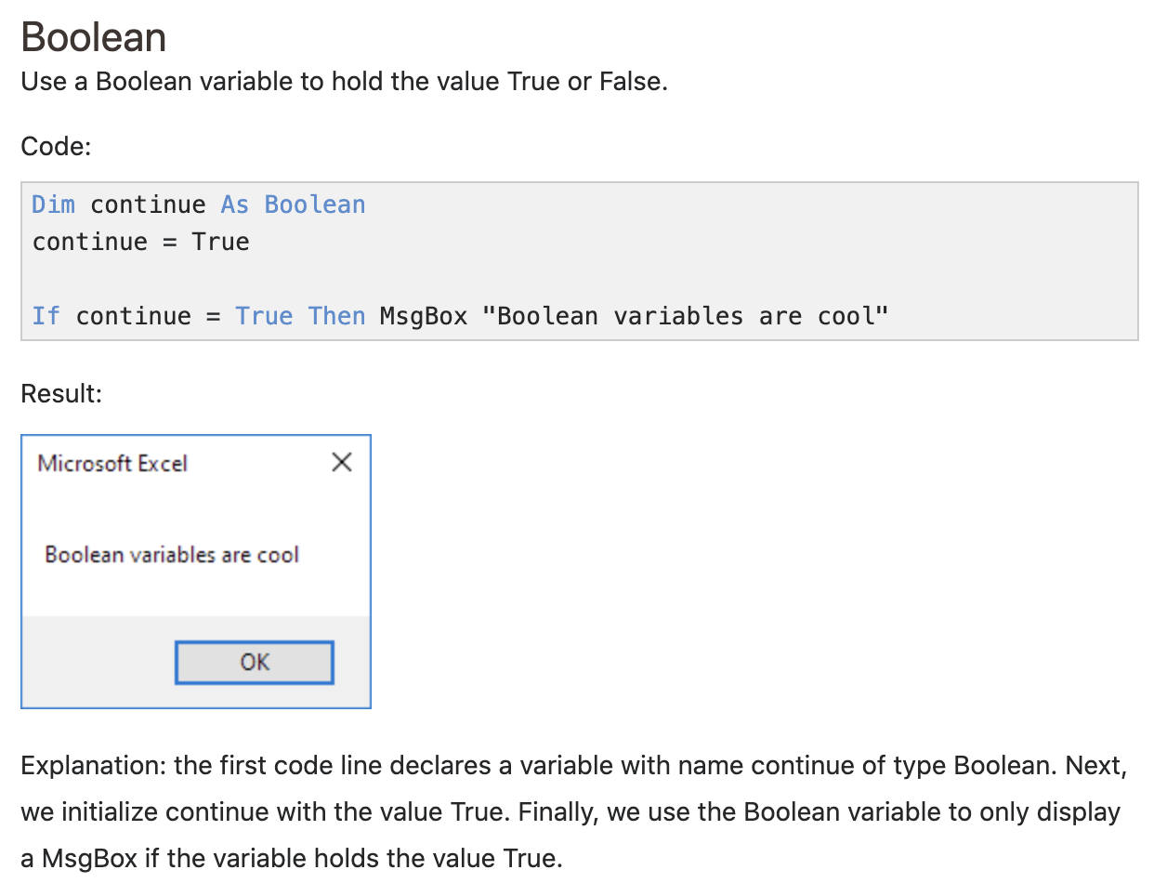
Boolean

Slide 9
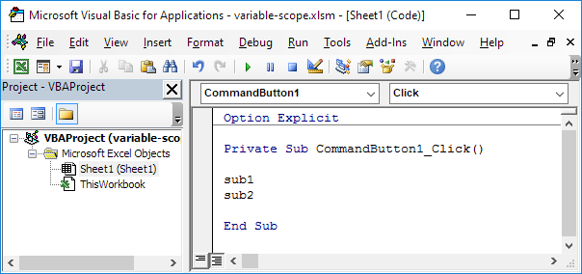
Variable scoping
The scope of a variable in Excel VBA determines where that variable may be used. You determine the scope of a variable when you declare it. There are three scoping levels: procedure level, module level, and public module level.
Place a command button on your worksheet and add the following code lines:

Slide 10
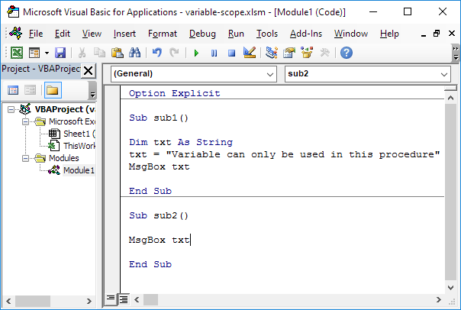
Variable scoping
1. Place the two procedures (a procedure is either a sub or a function) into a module. In the Visual Basic Editor, click Insert, Module. Add the following code lines:

Slide 11
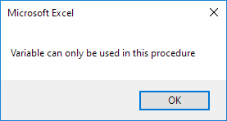
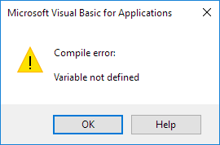
Variable scoping
2. Result when you click the command button on the sheet (call the two subs):
Explanation: the variable txt has scope procedure level because it is declared in the procedure (between Sub and End Sub). As a result, you can only use this variable in sub1. The variable txt cannot be used in sub2.

Slide 12
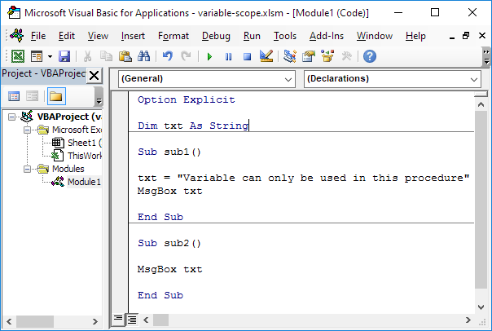
Variable scoping
3. When you want a variable to be available to all procedures in a module, you are saying you want the variable to have module level scope. You need to declare the variable in the General Declarations section (at the top of the module). Slightly adjust the code as follows:

Slide 13


Variable scoping
4. Result when you click the command button on the sheet:
Explanation: the variable txt can now be used in sub2. Module level is used interchangeably with private module level. That is because by default variables declared with the Dim statement in the General Declarations section are scoped as private. You can also scope a variable as public. Read on.

Slide 14
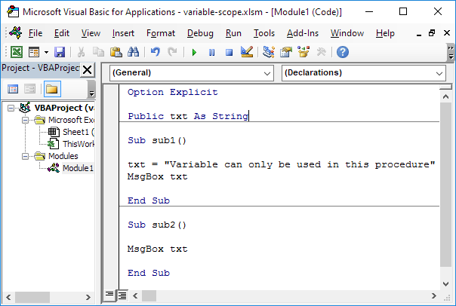
Variable scoping
5. By using the Public keyword, your variable will be available to all procedures in all modules in a workbook. This is called public module level scope. Slightly adjust the code as follows:
Explanation: now you can create a new module and place a sub called sub3 into this module. Use the same code as sub2. Add sub3 to your command button code. When you click the command button on the worksheet, you will get three message boxes saying "Variable can only be used in this procedure" (see downloadable Excel file).

Slide 15
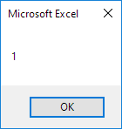

Life of Variables
2. Result when you click the command button on the sheet:
3. Result when you click another time:
Explanation: Excel VBA destroys the variable
when the procedure ends. Each time you
click the command button on the sheet,
Excel VBA creates the variable x again,
adds the value 1 to it, and displays the result.

Slide 16
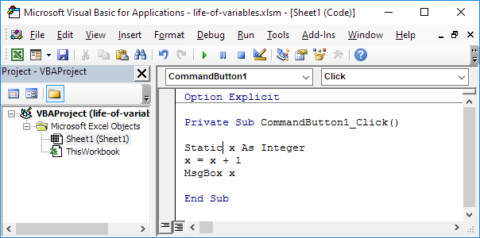
Life of Variables
4. Now replace the keyword Dim with the keyword Static.

Slide 17


Life of Variables
5. Result when you click the command button on the sheet:
6. Result when you click another time:
Conclusion: static variables retain their values, even when a procedure ends.
Note: static variables will be destroyed when you click the Reset (Stop) button or when you close your workbook.

